Slide 1
SplitCheck
Aniruddha Pimple
Brandon Patton
Chengzhi Yang
Fangzhou Zhang
Patrick Sommer
Shiyi Jiang

Slide 2
Description
Bill Splitting Mobile App.
Restaurants that are registered with the system will print out a QR code on the check.
With the client mobile app, users can scan the QR code. The app will automatically populate with the check information. As more users scan the code they will automatically be placed into the same group. The users can then select items from the bill and choose a payment method. Once all items are accounted for, the payment will process and pay the restaurant.

Slide 3

Targeted E - Efficiency
The team has focussed on the efficiency of splitting a restaurant bill.
Everyone that goes to a restaurant in a group needs to split the bill. Our app makes it very easy to split the bill including the taxes and the amount of tip each individual wants to give.
Each individual payment will translate into only one payment to the restaurant on behalf of the group.
Each individual walks away with only paying what he/she ordered without doing any calculation and it happens quickly.

Slide 4
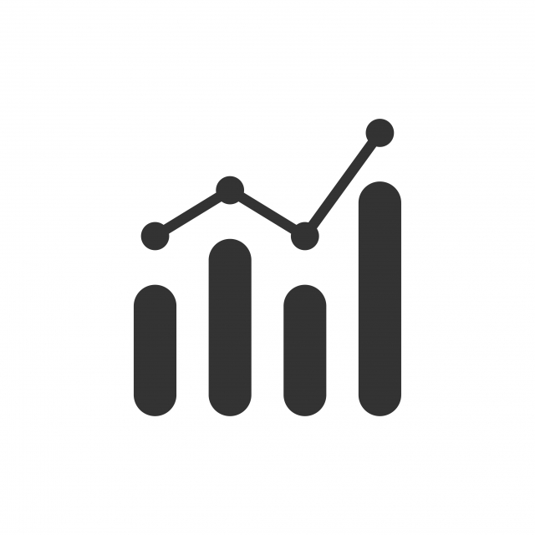
Measurement of Improvement: App Visit Frequency
Measuring how often the user visits the app and completes the transaction would be the determining factor of whether the user is using the application to split the bill.
Google Analytics service by Google Play would be a useful tool to check the frequency of the users in the Android Application.
If the user hasn’t logged in inside the app for approximately a month, then the user probably doesn’t find the app useful or go out to dinner often.
If the user visits the app at least once a month and completes a transaction, the user probably likes using the app to split the bill.

Slide 5
Measurement of Improvement: Useful Metrics
Time spent during a transaction
It will be crucial to understand if users are saving time by using the app and which parts is slowing them down.
How many other users are they splitting the bill with?
Depending on the average number of users splitting a bill the UI can be updated to ensure an easier flow.
What restaurants and items are popular?
This can be used for marketing and detecting market trends such as popular restaurants, popular food choices, and how often and when people are dining in groups (example around holidays, summer, weekends). As a central payment center collecting market analytics can be useful to plan for future use cases, features, promotions, partnerships.

Slide 6
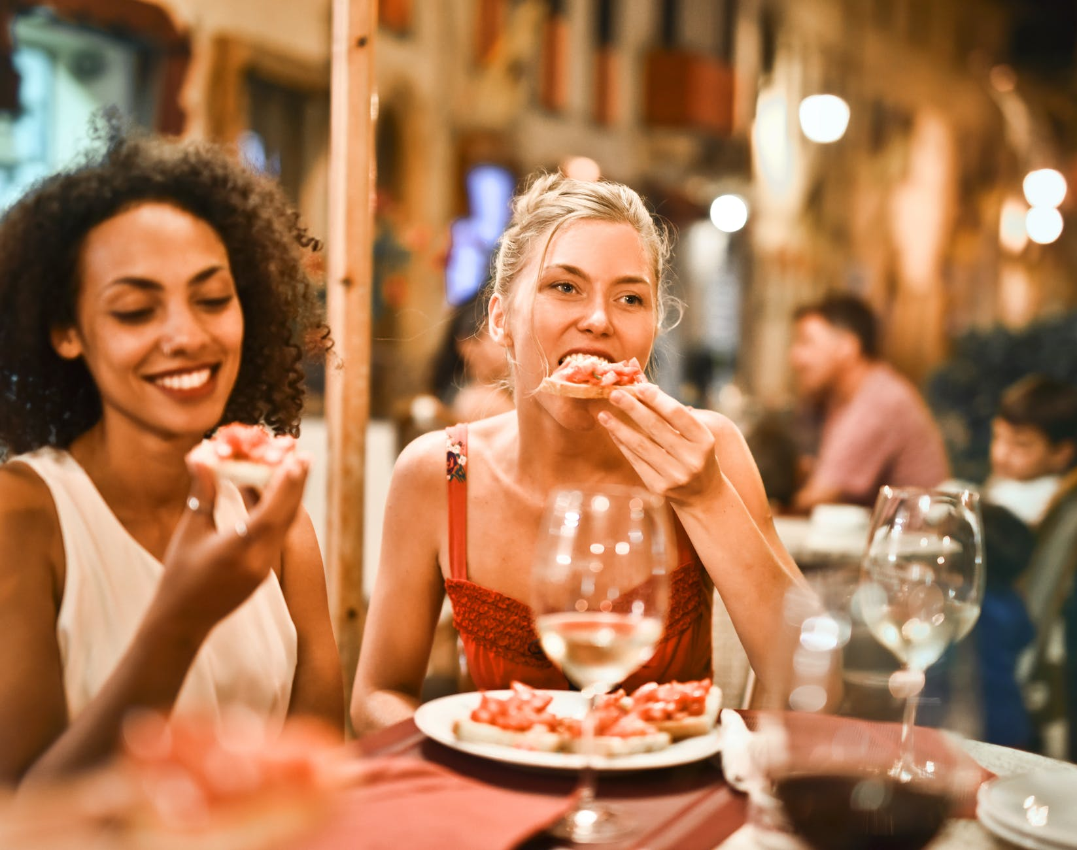
Target Population
Our target population is the people who go to a restaurant in a group.
They would mostly contain millennials or technology enthusiasts who loves to use applications for ease.
Every day millions of people go to restaurants to eat food and almost every one of them has a cell phone, and can easily use a phone application.

Slide 7

Preliminary User Survey Results & Industry Data
Before using any version of SplitCheck, we gave test users a preliminary survey. The results reflected the following :
Majority of users find it difficult to split a check with a large group
All test users would consider paying with an app
The majority want a more efficient way to split the check
Most take time to calculate the tip accurately, while a few overpay to take less time calculating
Almost nobody wants to pay with cash
Usually, one person pays and everyone in the group pays that person later (if they remember)

Slide 8

Persona
Steven has an average skill level with mobile apps. He likes to go out for dinner with a group of his friends in New York.
However, he does not like to split the bill evenly and only wants to pay for his items. He likes to use apps like Venmo but finds it a struggle to know how much each person owes, and it is difficult for his friend to remember the money for their items. Sometimes the sum of the money everyone transfers to him is not the same as he paid for the meal. What is more, he often feels he overpays since his friends forget to include tax and tip. Steven does not want to waste time doing math while trying to enjoy dinner.
Persona based on preliminary survey results

Slide 9
User story
It is a weekend night. Steven is at TGI Fridays with a group of 8 friends. His friends order a lot of food and expensive cocktails, but Steven only had a Cheeseburger and a soda.
When it is time to pay the check, one friend suggests splitting the bill evenly so they don’t have to add up their items. Another friend suggests one person pays the bill and everyone pays that person. Steven dislikes both these options. He thinks the first suggestion is unfair, and the second is too troublesome.
At this time, he notices a QR code at the bottom of the check. It also says “Use SplitCheck mobile app to easily pay your bill with friends!” The waitress notices Steven looking at the QR code and also suggests using the app.
The group downloads the app and with a quick and easy setup, use SplitCheck to pay their own part conveniently. Everyone paid for exactly what they had and say they will use it again next time.

Slide 10
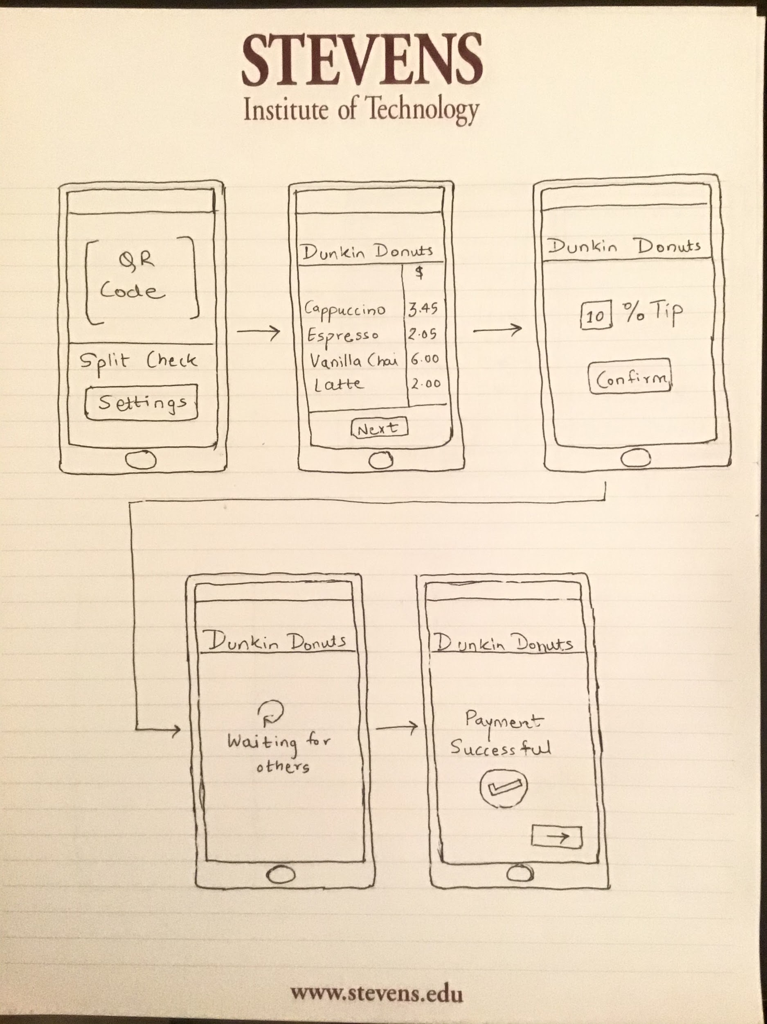
First Design (Paper based prototype)

Slide 11

User feedback - First Design
If people in the group ordered the same item twice, it would come twice in the restaurant check.
It would be useful to split the bill between large groups of people.
There’s no indication of the amount of tip that you’ll actually give, only percentage.
There’s no way of knowing who is paying what in the group.

Slide 12
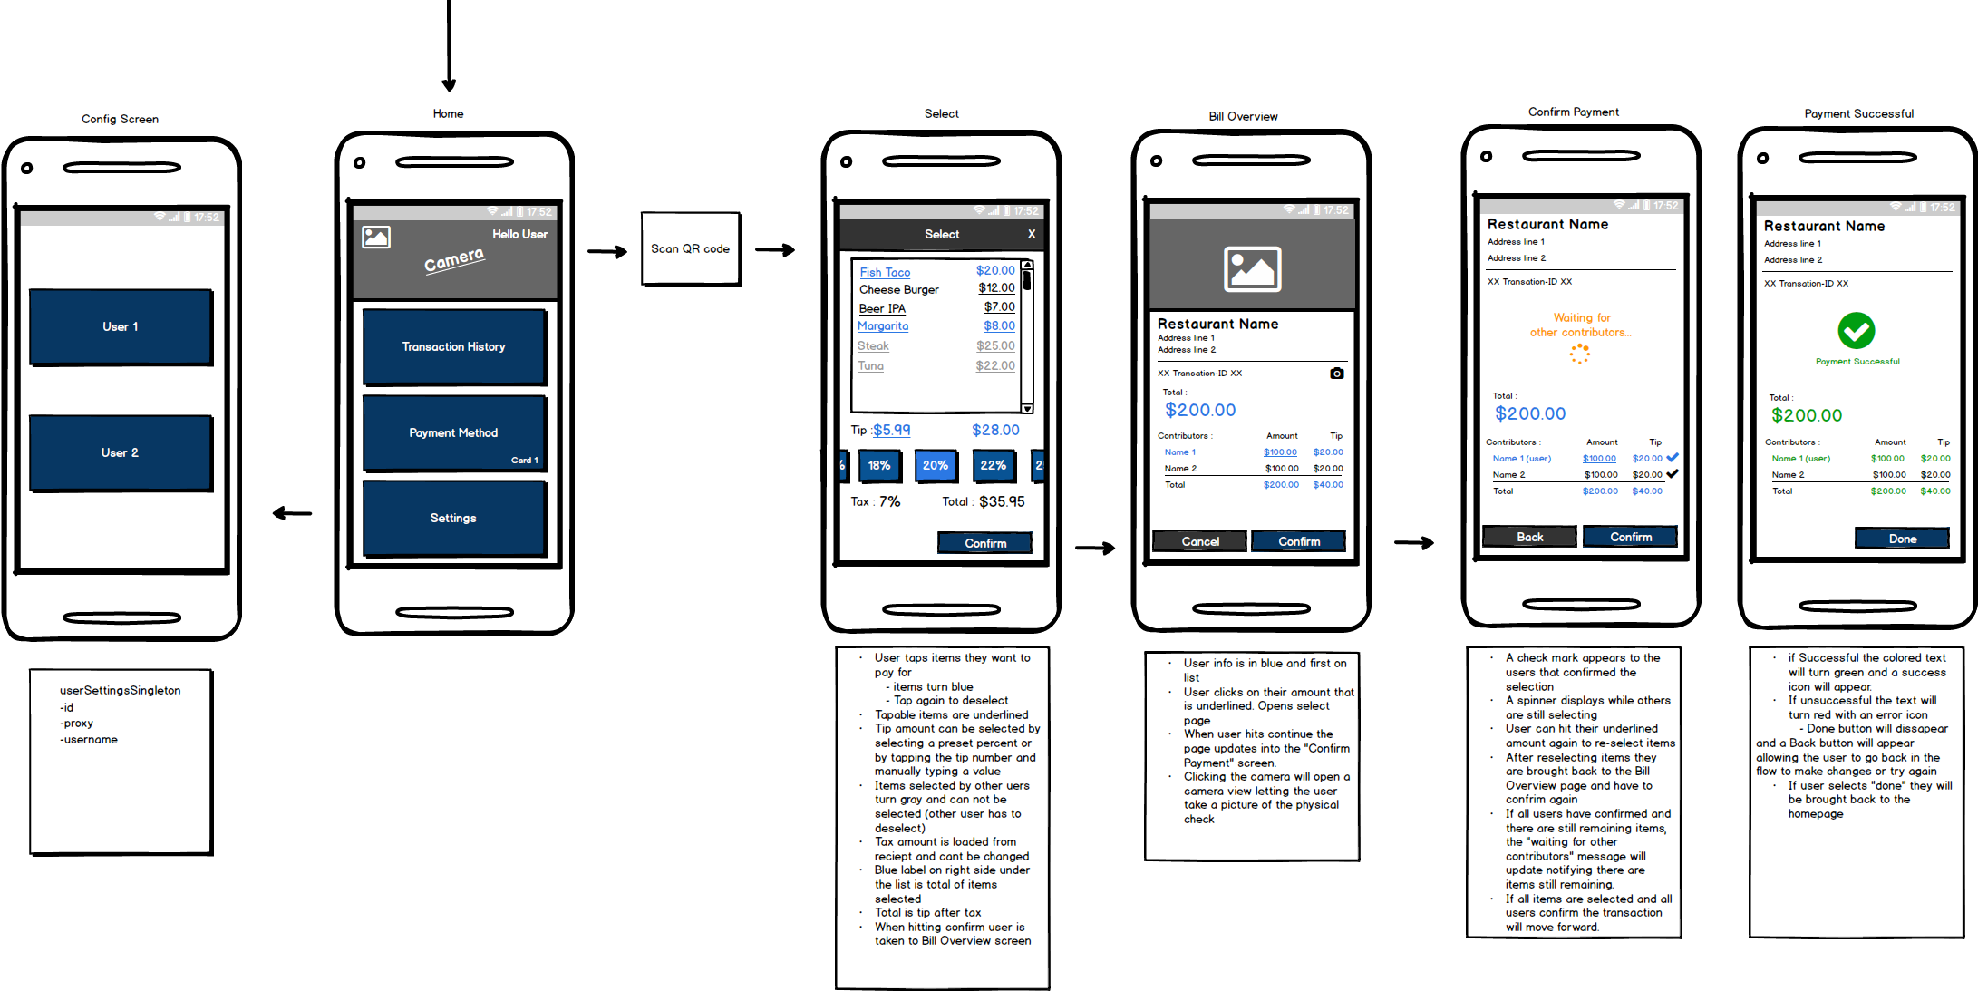
Second Design (Prott Prototype)
We made a runnable click-through prototype using Balsamiq and Prott. The prototype had clickable hotspots to guide test users through the experience.

Slide 13
User Feedback - Second Design
Some feature is highly abstract(mimic by clicking the image). Users can not actually experience it.
The experience is intuitive.
Designs could use some color
Hard to imagine the live updates from other users, but felt the flow was simple.

Slide 14
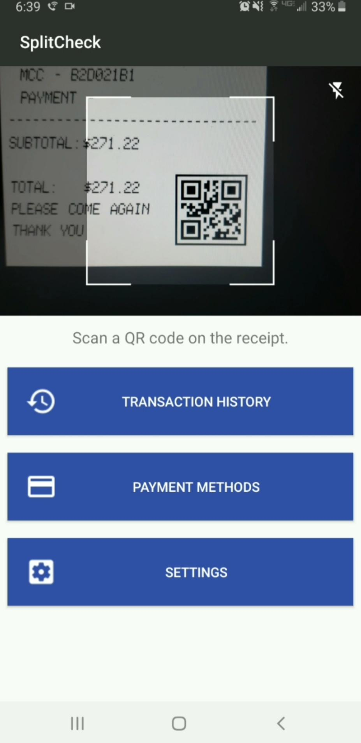
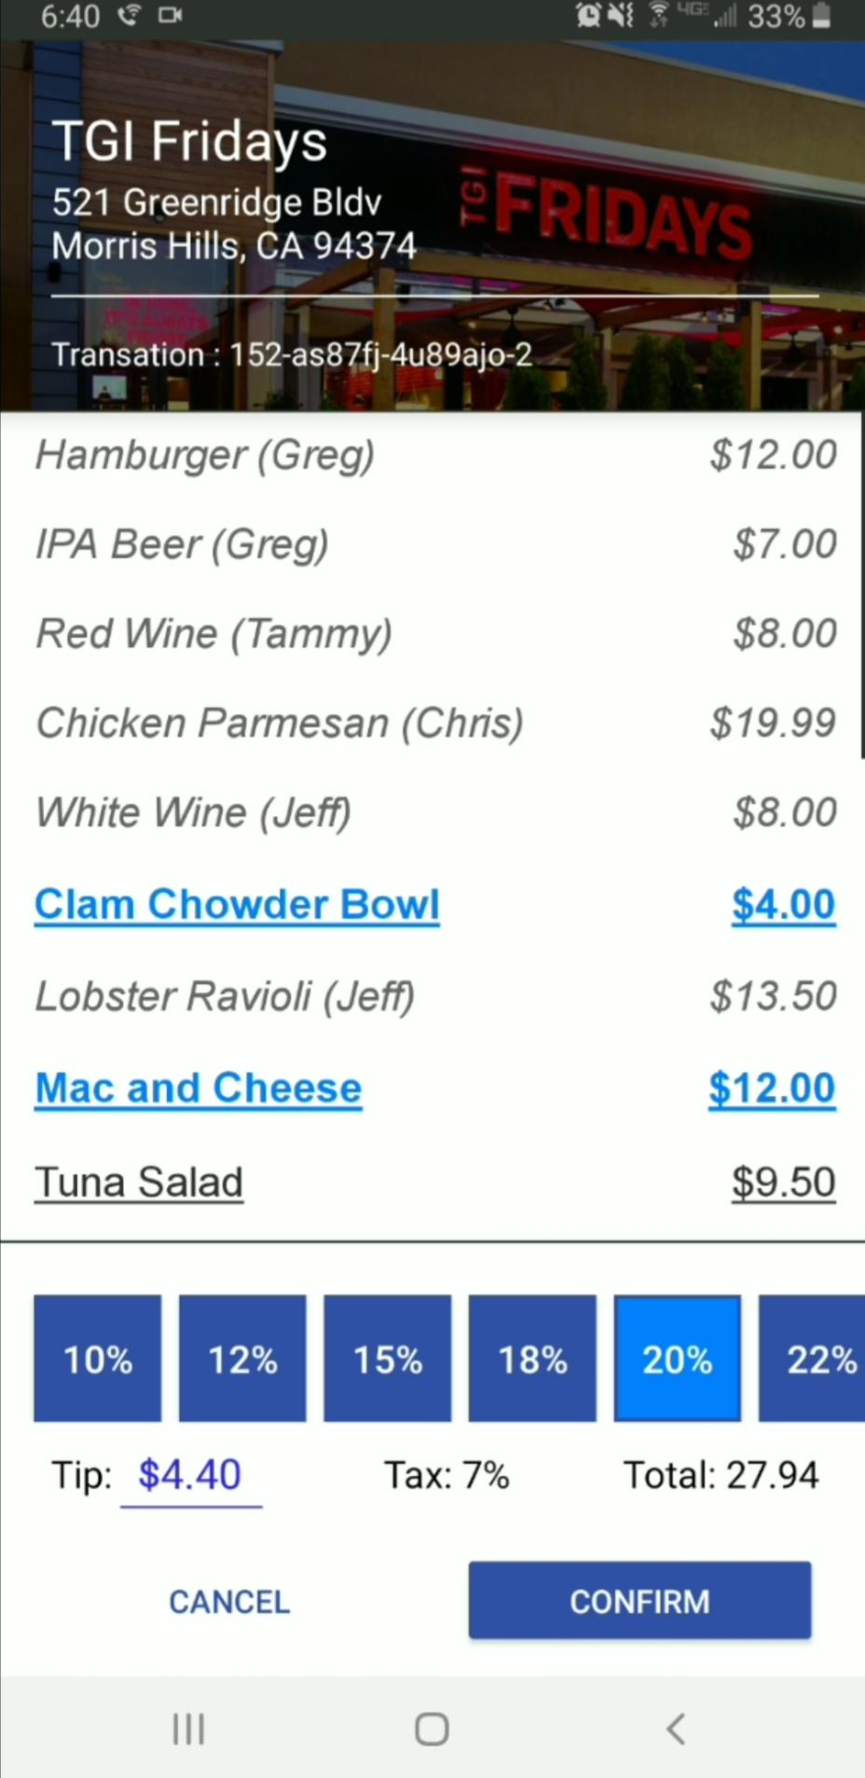
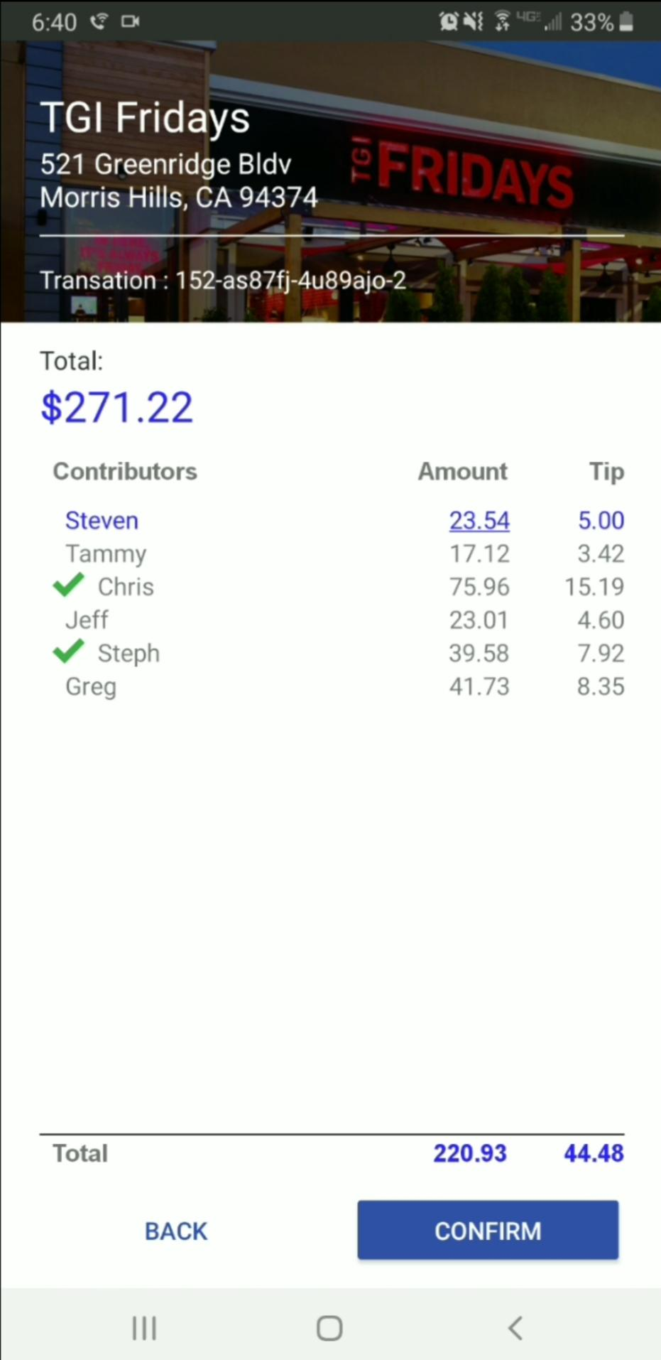
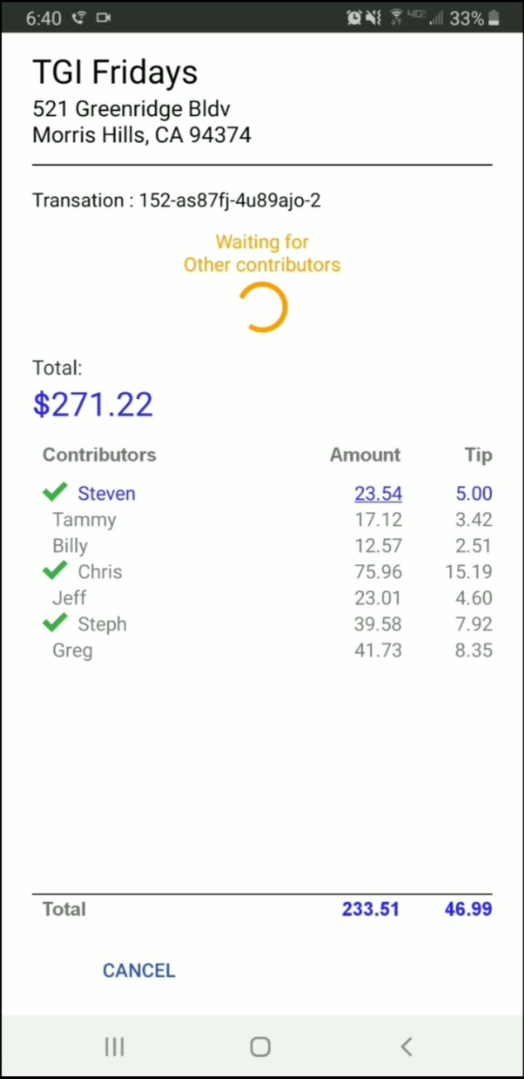
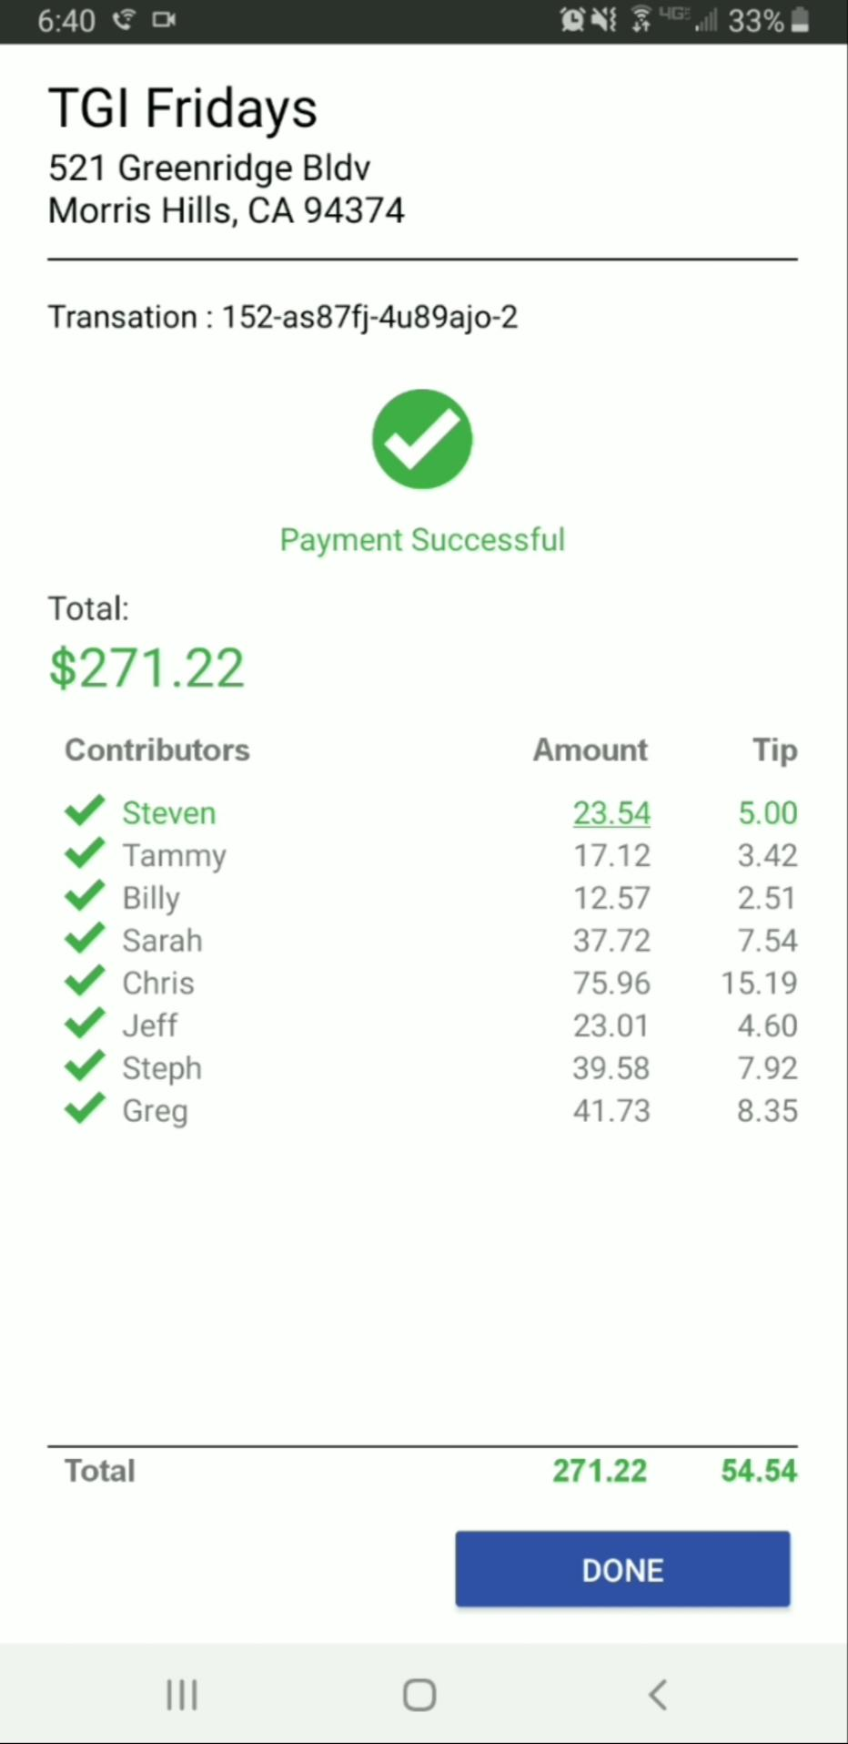
Final Design
For the final design, we wrote a native Android app. We added the QR code scanning functionality, images, and simulated other users selecting items in a realistic manner.

Slide 15
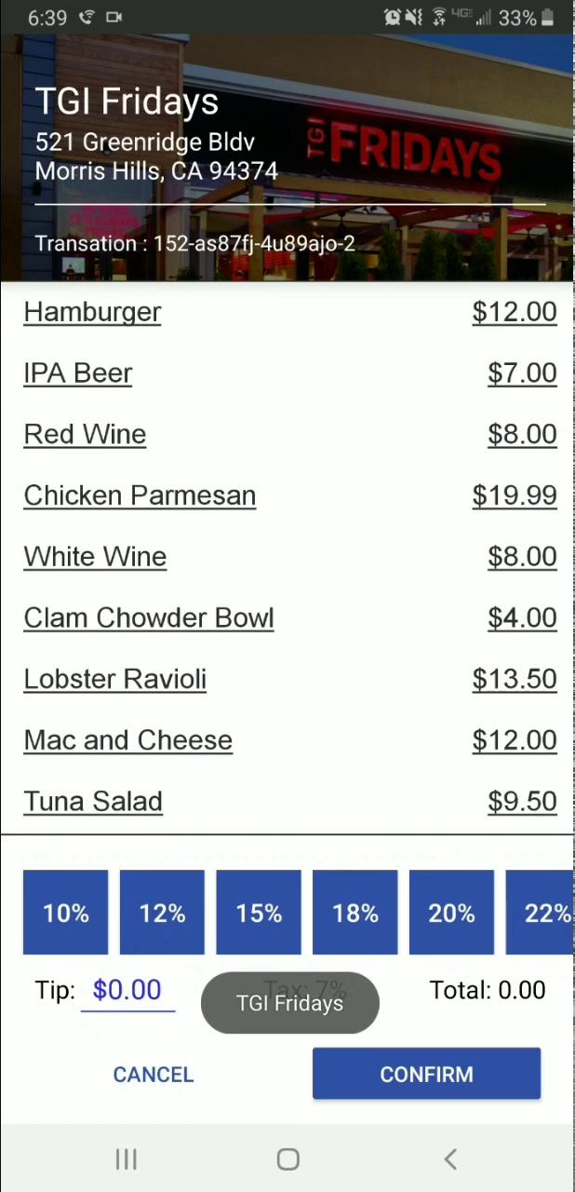
Demo/Walkthrough of Final Design
Demo video link:
http://bit.ly/2PfsHZp
Click to play

Slide 16
PAR Review
Perception: The android application has a simple and aesthetic design taking into consideration, Kent Beck’s 4 simple design principles. The colors and action buttons improve the perception of the system，it is also friendly to people with disabilities, such as color-blind users, and make the user understand what to do next.
Attention: The application takes the user’s attention as long as the bill-paying process is complete. The user is engaged by real-time updates by other friends by the item they are choosing to pay and constant feedback on the status of the bill-paying process.
Retention: The application ensures that the user only needs to remember the food items the user consumed to be able to choose to pay for those items. The bill would consist of all the item names and their prices.

Slide 17

Simplicity Review
Time: When the bill is supposed to be split between a group of people, there is a fair amount of math involved with the number of items, their prices, additional tax, etc. The application reduces the time that is needed to calculate the split since the app does it for you. You just have to select the items and the payment method and the application takes care of the rest.

Slide 18
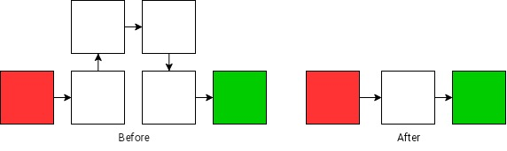
Simplicity Review
Reduce: By choosing our product, users can reduce the procedure when splitting the bill. For example, in the normal case of a group dinner, one of the groups will make a payment, then we usually use a calculator application to divide the bill number, make a transfer to the payer using another financial application such as Venmo, or Paypal. Through our product, the user will receive their own bill by splitting, they don't need to calculate or transfer anymore.

Slide 19

Accessibility Evaluation
Since the app handles financial transactions it is important accessibility is a priority.
When users are selecting items from the item list the item updates in color and font. All items that are selectable have an underline while items selected by other users do not. This helps assist users who can not see well.
For people impaired with blindness, Android’s screen reader will assist them through the page. Future steps will be to ensure the screen reader is accurately reading and navigating the page.

Slide 20
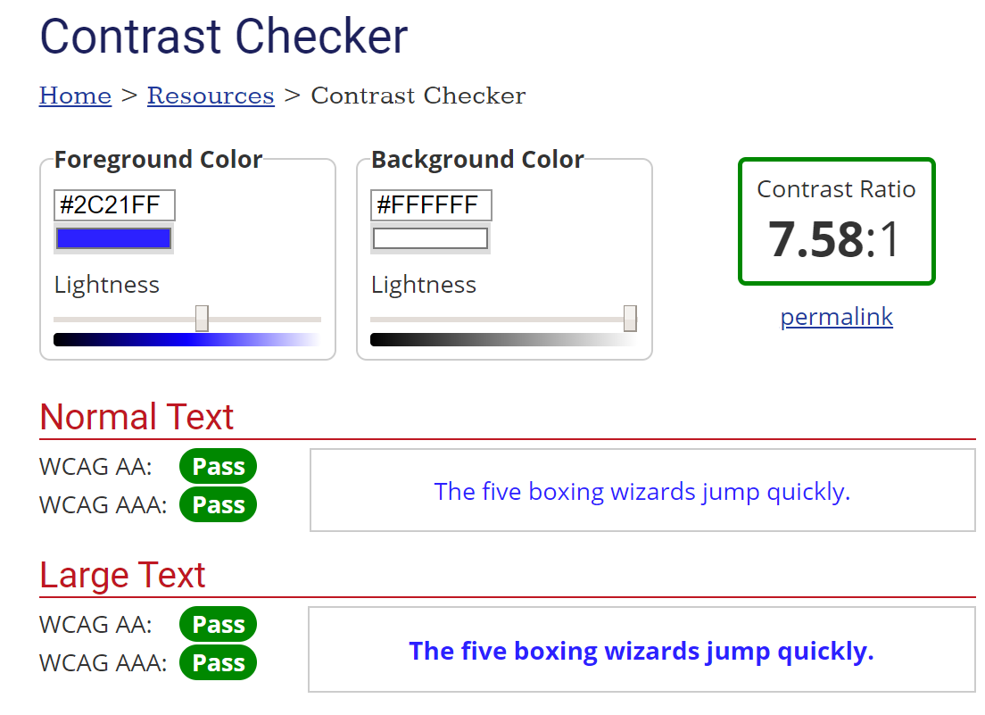
Accessibility Evaluation
To test color contrast, we used WebAim color checker.
https://webaim.org/resources/contrastchecker/
Ensuring a minimum AA rating with a 3:1 ratio for all colors against backgrounds.
Colors in similar components, such as selecting tip, have also been tested against each other to ensure selection is visible.

Slide 21
Heuristic Evaluation
Using Kessler’s Heuristic Evaluation points
Simple and natural language
The easy dialog to guide user for each step, no complex introduction or phrases
Minimize the user’s memory
No need to calculate or remember the exact number to make a payment
Consistency
Provide payment history on the first screen
Feedback
Provide success/fail/progress feedbacks when checking

Slide 22
Heuristic Evaluation
Using Kessler’s Heuristic Evaluation points
Shortcuts
Scan barcode to get the payment information, type a button for tips rather than inputting a number
Prevent Errors
Provide tips buttons, users won’t type the wrong input when tipping
Clearly marked exits
A cancel button at the button for users to exit at every step of checking

Slide 23

Final Data from Users
After using SplitCheck, our survey reported the following from the test users :
Everyone agreed that SplitCheck made this process easier and would consider using an app like SplitCheck.
The user’s opinion of using app interfaces to split checks improved slightly after using SplitCheck, with several users marking “for the better” describing their opinion change.
Being able to specifically select paid items and tip made the process of paying for separate items in groups easier for a majority of users
All users felt informed about how much they would have paid.
All users felt SplitCheck’s tip calculation was helpful
This is significant because several users had sometimes overpaid instead of calculating tips out of convenience.

Slide 24
Final Data from Users - Targeted E Efficiency
Almost all users agreed that efficiency is important when paying for food in a group before testing SplitCheck:
All users ended up agreeing that SplitCheck overall made splitting up the items of a check easier and more efficient than otherwise
All users agreed that SplitCheck made the process of splitting a check more efficient.
This is important because our targeted E is Efficiency.
Everyone’s opinion on paying with apps like SplitCheck changed for the better
This is important feedback; targeted E was not brought down by app interface

Slide 25

Future Work
UI stylish need to improve
After further changes, we need new development iteration
Splitting a single item between multiple users. Example an appetizer.
Error handling
What happens if an item is not selected by any user?
What if only one user has a service error during payment?
Splitting the check evenly.
Although the app drives to allow users to select their items, many groups may want to simply split the check evenly.
Ensure Accessibility Voice Over is accurate for ADA compliance

Slide 26
References
Photos
https://www.pexels.com/photo/woman-eating-bruschetta-1537635/
Prottapp
https://prottapp.com/

